Slide 1
Unit 10. Convolutional and Deep Neural Networks
EE-uy 4563/EL-GY 9143: Introduction to machine learning
Prof. Sundeep rangan modifications by Yao Wang (NYU), Phil Schniter (OSU)

Slide 2
Outline
Motivation: ImageNet Large-Scale Visual Recognition Challenge (ILSVR)
Deep Networks and Feature Hierarchies
2D convolutions
Convolutional neural networks
Creating and visualizing convolutional layers in Keras
Training CNNs: Backpropagation, Batch-norm, Dropout, etc.
Transfer Learning from Famous Pre-trained Networks

Slide 3
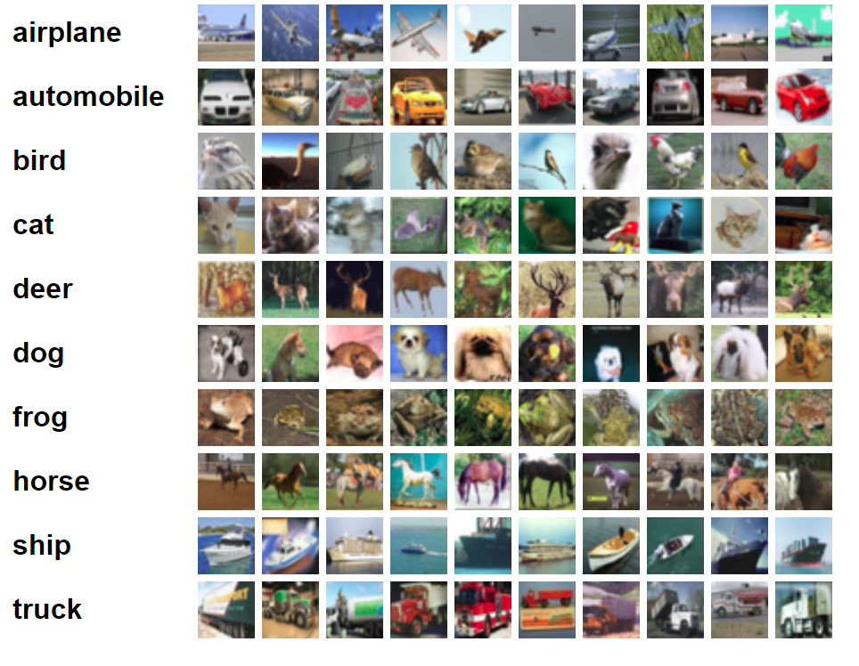
Dataset Pre-2009
Pre-2009, many image recognition systems worked on relatively small datasets
MNIST:
10 classes, 70,000 examples, 28 x 28 images
CIFAR 10 (right)
10 classes, 60000 examples, 32x32 color
CIFAR 100:
100 classes, 600000 examples, 32x32 color
PASCAL VOC:
20 classes, 11530 examples, variable size images
Performance saturated
Difficult to make significant advancements
https://www.cs.toronto.edu/~kriz/cifar.html

Slide 4
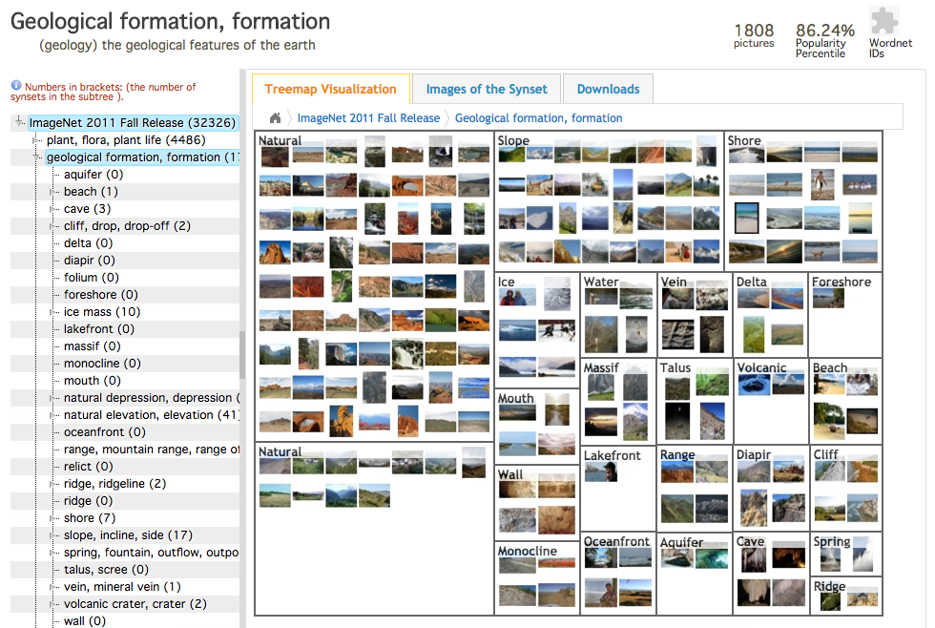
ImageNet (2009)
Better algorithms need better data
ImageNet:
Goal: “map out the entire world of objects” (see this great article)
3.2 million images
Annotated by Amazon mechanical turk
Hierarchical categories
Details in 2009 CVPR paper
Deng, J., Dong, W., Socher, R., Li, L. J., Li, K., & Fei-Fei, L. (2009, June). Imagenet: A large-scale hierarchical image database. In Computer Vision and Pattern Recognition, 2009. CVPR 2009. IEEE Conference on (pp. 248-255). IEEE.

Slide 5
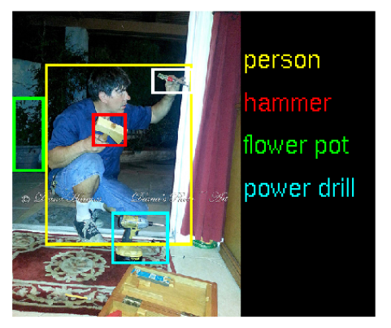
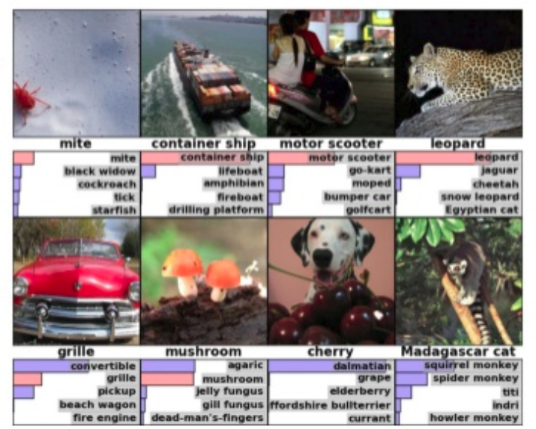
ILSVRC
ImageNet Large-Scale Visual Recognition Challenge held yearly 2010-2017
Challenging!
Classification: 1000 classes, label 5 objects per image
Fine-grained classification: 120 dog categories
Objects in many positions, scales, rotations, lightings, occlusions . . .
Phil…

Slide 6
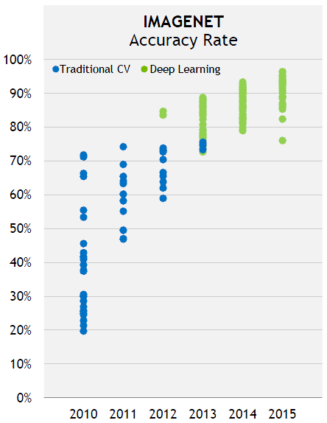
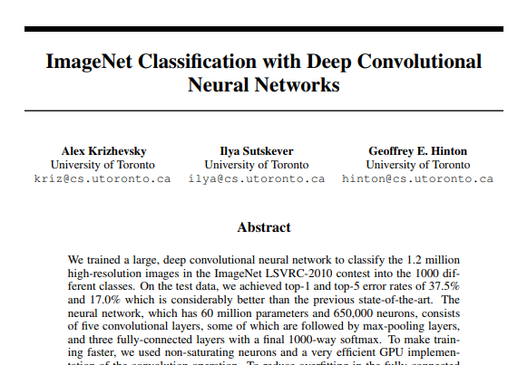
Deep Networks Enter in 2012
2012: Stunning breakthrough by the first deep network
“AlexNet” from Hinton Group at U Toronto
Easily won ILSVRC competition
Top-5 error rate: 15.3%
Second place: 25.6%
Soon, all competitive methods are deep networks

Slide 7
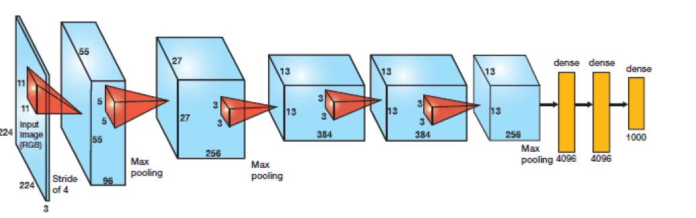
Alex Net
Key idea: Build a very deep neural network
60 million parameters, 650000 neurons
5 conv layers + 3 FC layers
Final is 1000-way softmax

Slide 8
Outline
Motivation: ImageNet Large-Scale Visual Recognition Challenge (ILSVR)
Deep Networks and Feature Hierarchies
2D convolutions
Convolutional neural networks
Creating and visualizing convolutional layers in Keras
Training CNNs: Backpropagation, Batch-norm, Dropout, etc.
Transfer Learning from Famous Pre-trained Networks

Slide 9
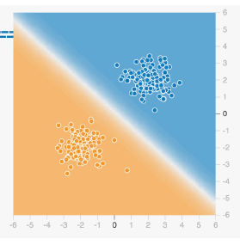
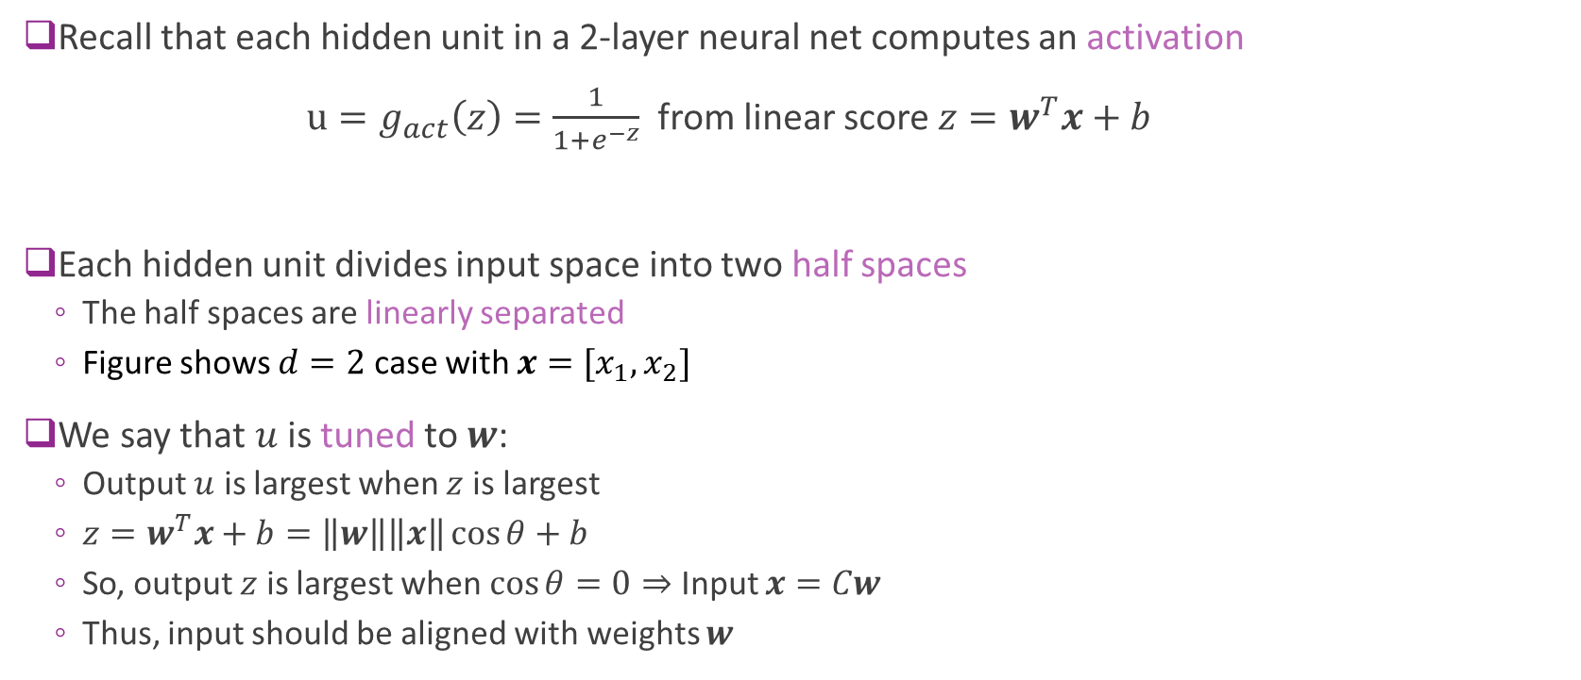
Review of Neural Networks: Hidden Layer
Recall that each hidden unit in a 2-layer neural net computes an activation
$u=g_{act}\left(z\right)=\frac{1}{1+e^{−z}}$from linear score $z=w^{T}x+b$
Each hidden unit divides input space into two half spaces
The half spaces are linearly separated
Figure shows $d=2$ case with $x=[x_{1},x_{2}]$
We say that $u$ is tuned to $w$:
Output $u$ is largest when $z$ is largest
$z=w^{T}x+b=\left\|w\right\|\left\|x\right\|\cos{θ}+b$
So, output $z$ is largest when $\cos{θ}=0⇒$ Input $x=Cw$
Thus, input should be aligned with weights $w$

Slide 10
Review of Neural Networks: Output Layer
Two-layer neural networks:
Implement nonlinear boundaries
Built from intersections of linear regions
Picture to left:
Output of Tensorboard
Tool in TensorFlow
Provided for visualizing neural nets
From Kaz Sato, “Google Cloud Platform Empowers
TensorFlow and Machine Learning”

Slide 11
What about a More Complicated Region?

Slide 12
Use Multiple Layers
More hidden layers
Hierarchies of features
Generate very complex shapes

Slide 13
Can you Classify This?

Slide 14
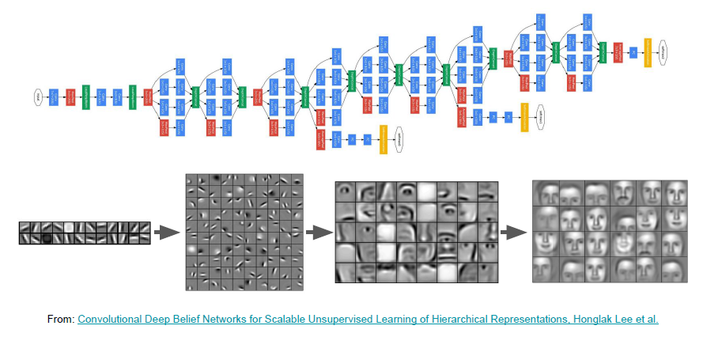
Build a Deep Neural Network

Slide 15
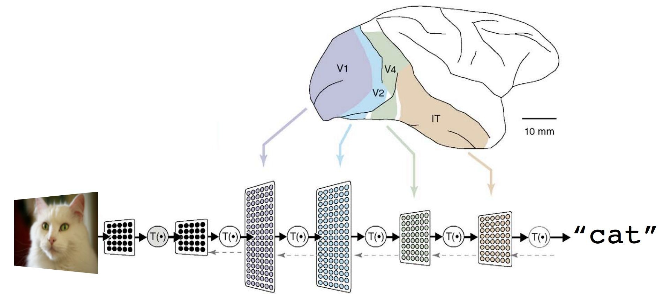
Biological Inspiration
Processing in the brain uses multi-layer processing

Slide 16
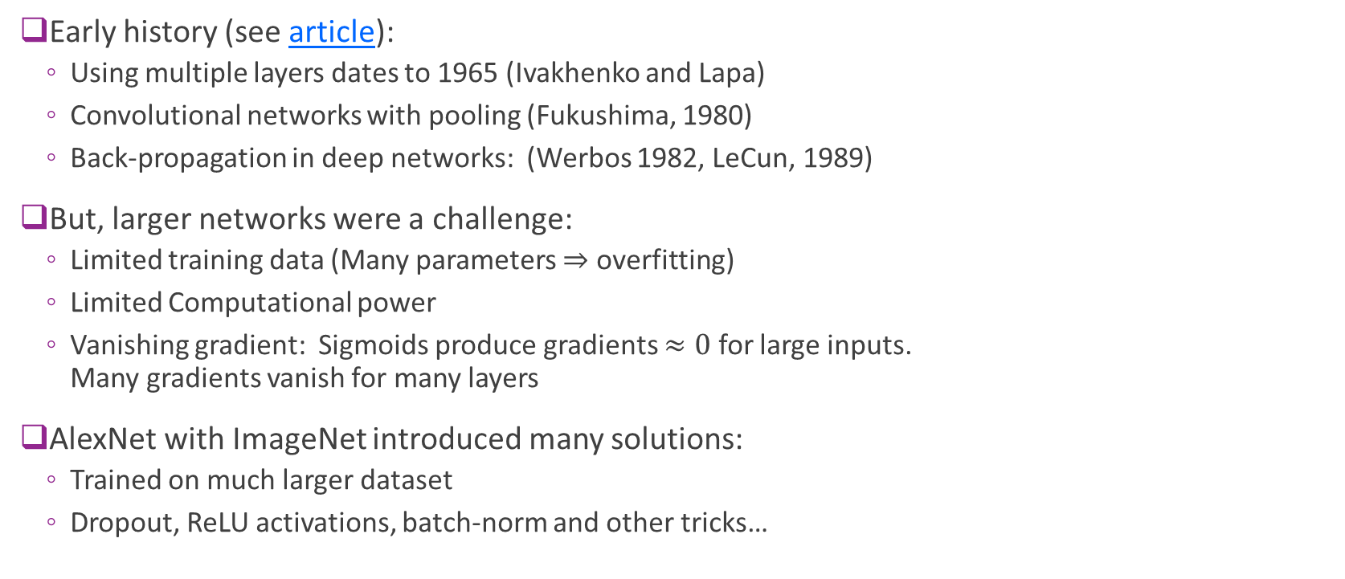
History and Why Now?
Early history (see article):
Using multiple layers dates to 1965 (Ivakhenko and Lapa)
Convolutional networks with pooling (Fukushima, 1980)
Back-propagation in deep networks: (Werbos 1982, LeCun, 1989)
But, larger networks were a challenge:
Limited training data (Many parameters $⇒$ overfitting)
Limited Computational power
Vanishing gradient: Sigmoids produce gradients $≈0$ for large inputs. Many gradients vanish for many layers
AlexNet with ImageNet introduced many solutions:
Trained on much larger dataset
Dropout, ReLU activations, batch-norm and other tricks…

Slide 17
Outline
Motivation: ImageNet Large-Scale Visual Recognition Challenge (ILSVR)
Deep Networks and Feature Hierarchies
2D convolutions
Convolutional neural networks
Creating and visualizing convolutional layers in Keras
Training CNNs: Backpropagation, Batch-norm, Dropout, etc.
Transfer Learning from Famous Pre-trained Networks

Slide 18
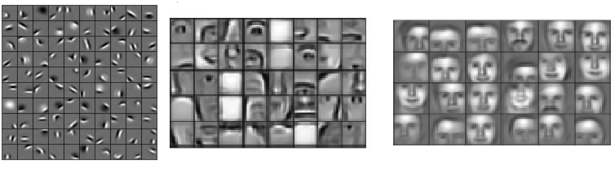
Local Features
Early layers in deep neural networks often find local features
Small patterns in larger image
Examples: Small lines, curves, edges
Subsequent layers combine local features to create more complex features
The features can be located anywhere
How do we find them?

Slide 19
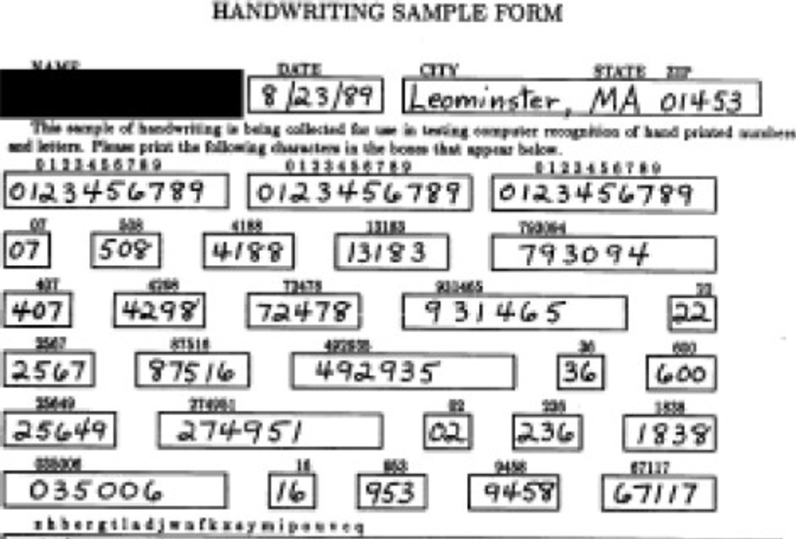
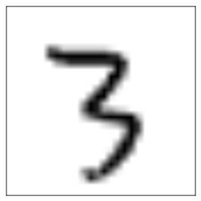
Local Features
How do we find local features?
A localization problem.
Example: Find the digit “3” in the form

Slide 20
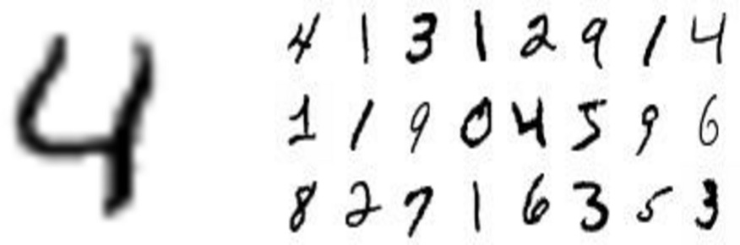
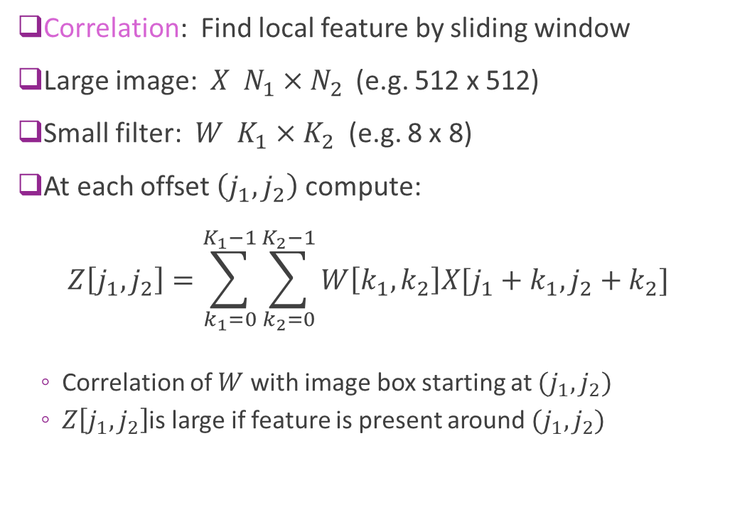
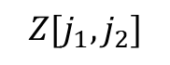


Localization via “Correlation”
Correlation: Find local feature by sliding window
Large image: $X N_{1}×N_{2}$ (e.g. 512 x 512)
Small filter: $W K_{1}×K_{2}$ (e.g. 8 x 8)
At each offset $\left(j_{1},j_{2}\right)$ compute: $Z\left[j_{1},j_{2}\right]=\sum_{k_{1}=0}^{K_{1}−1}{\sum_{k_{2}=0}^{K_{2}−1}{W\left[k_{1},k_{2}\right]X[j_{1}+k_{1},j_{2}+k_{2}]}}$
Correlation of $W$ with image box starting at $(j_{1},j_{2})$
$Z\left[j_{1},j_{2}\right]$is large if feature is present around $(j_{1},j_{2})$
Filter $W$
Image $X$
$$Z[j_{1},j_{2}]$$
High
Low

Slide 21
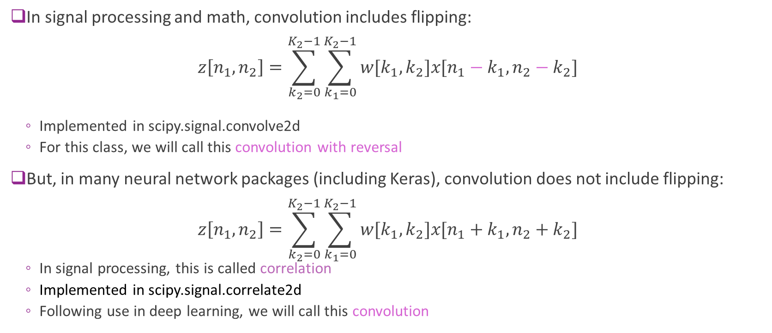
Terminology
In signal processing and math, convolution includes flipping: $z\left[n_{1},n_{2}\right]=\sum_{k_{2}=0}^{K_{2}−1}{\sum_{k_{1}=0}^{K_{2}−1}{w[k_{1},k_{2}]x[n_{1}−k_{1},n_{2}−k_{2}]}}$
Implemented in scipy.signal.convolve2d
For this class, we will call this convolution with reversal
But, in many neural network packages (including Keras), convolution does not include flipping: $z\left[n_{1},n_{2}\right]=\sum_{k_{2}=0}^{K_{2}−1}{\sum_{k_{1}=0}^{K_{2}−1}{w[k_{1},k_{2}]x[n_{1}+k_{1},n_{2}+k_{2}]}}$
In signal processing, this is called correlation
Implemented in scipy.signal.correlate2d
Following use in deep learning, we will call this convolution

Slide 22
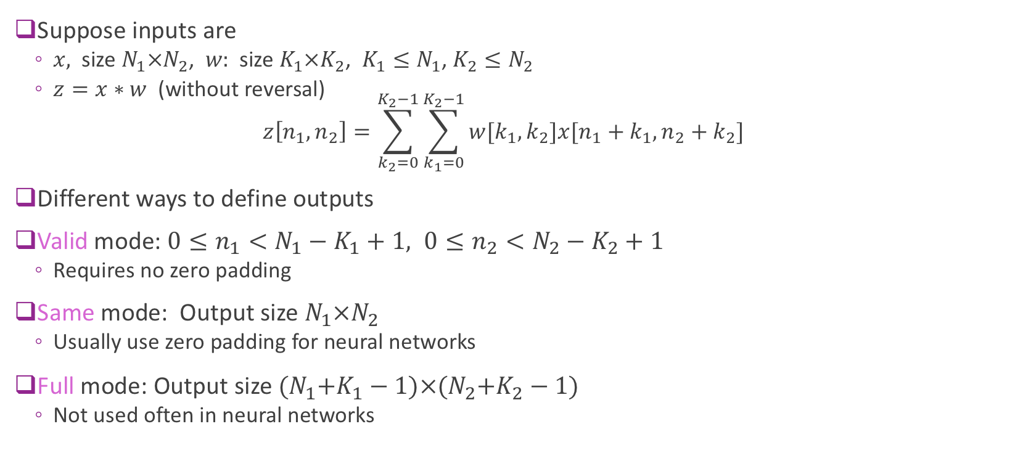
Boundary Conditions
Suppose inputs are
$x,$ size $N_{1}×N_{2}$, $w:$ size $K_{1}×K_{2}$, $K_{1}≤N_{1}$, $K_{2}≤N_{2}$
$z=x∗w$ (without reversal) $z\left[n_{1},n_{2}\right]=\sum_{k_{2}=0}^{K_{2}−1}{\sum_{k_{1}=0}^{K_{2}−1}{w[k_{1},k_{2}]x[n_{1}+k_{1},n_{2}+k_{2}]}}$
Different ways to define outputs
Valid mode: $0≤n_{1}<N_{1}−K_{1}+1, 0≤n_{2}<N_{2}−K_{2}+1$
Requires no zero padding
Same mode: Output size $N_{1}×N_{2}$
Usually use zero padding for neural networks
Full mode: Output size ${(N}_{1}+K_{1}−1)×{(N}_{2}+K_{2}−1)$
Not used often in neural networks

Slide 23
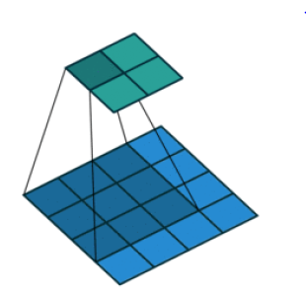
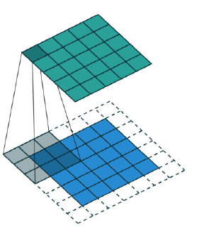



Boundary Conditions Illustrated
There are three ways to handle boundary conditions
See excellent github with animated gifs
Valid mode (no zero padding)
Output shape:
$\left(N_{1}−K_{1}+1\right)×(N_{2}−K_{2}+1)$
Same mode (half zero padding)
Output shape:
$$N_{1}×N_{2}$$
Full mode (full zero padding)
Output shape:
$$\left(N_{1}+K_{1}+1\right)×(N_{2}+K_{2}+1)$$

Slide 24
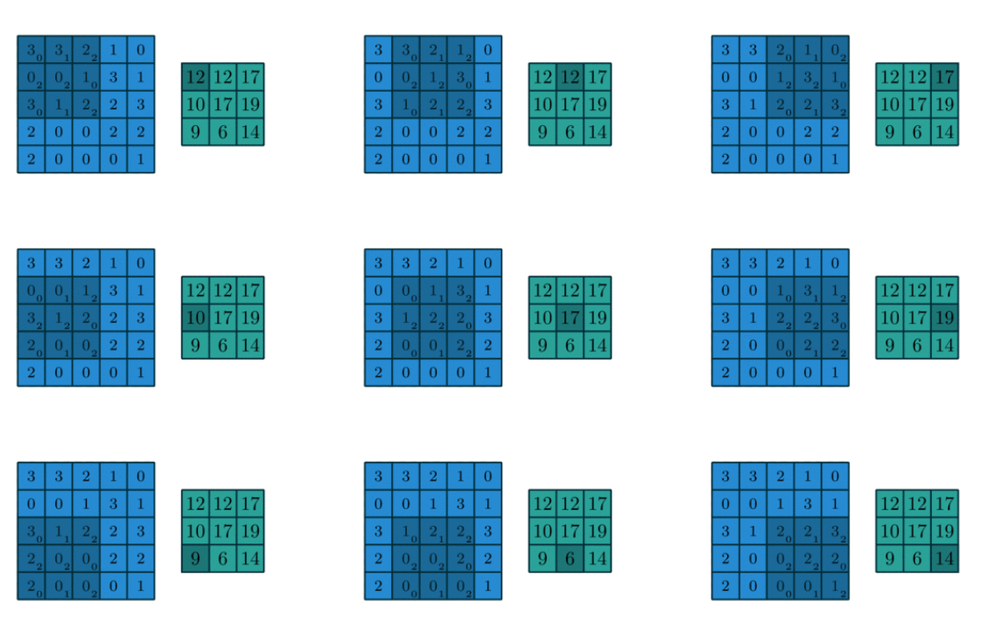
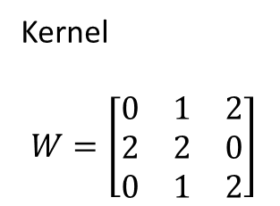
2D Convolution Example with Valid Mode
Kernel
$$W=\left[\begin{matrix}0 & 1 & 2 \\ 2 & 2 & 0 \\ 0 & 1 & 2\end{matrix}\right]$$

Slide 25
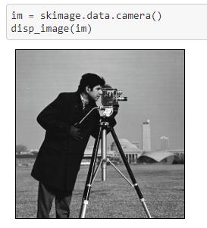
Example Convolution in Python
We now demonstrate 2D convolution in Python
We use the following packages:
skimage: Image processing
scipy signal: For signal processing
We experiment with “cameraman” image
Famous image in image processing
Built-in image skimage.data
We examine two convolutions:
Local averaging / blurring
Edge detection

Slide 26
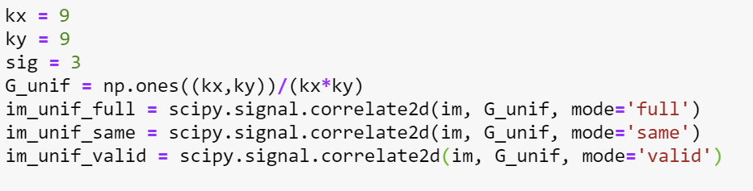

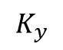

Ex 1. Convolution for Local Averaging
First, consider convolving with a uniform kernel
Each output is a local average of the input
Visually, this blurs the image
Amount of blurring increases with kernel size
$$G=\frac{1}{K_{x}K_{y}}\left[\begin{matrix}1 & ⋯ & 1 \\ ⋮ & ⋱ & ⋮ \\ 1 & ⋯ & 1\end{matrix}\right]$$
$$K_{y}$$
$$K_{x}$$

Slide 27
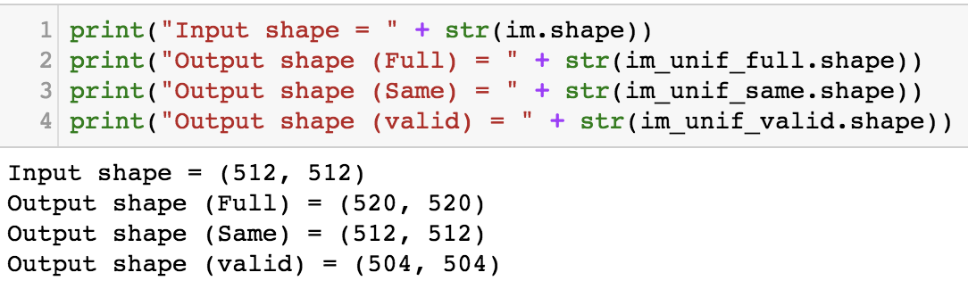
Illustration of Boundary Conditions
Notice the black pixels at the boundaries when using same or full mode
These arise from zero padding

Slide 28
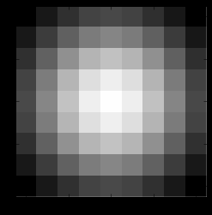
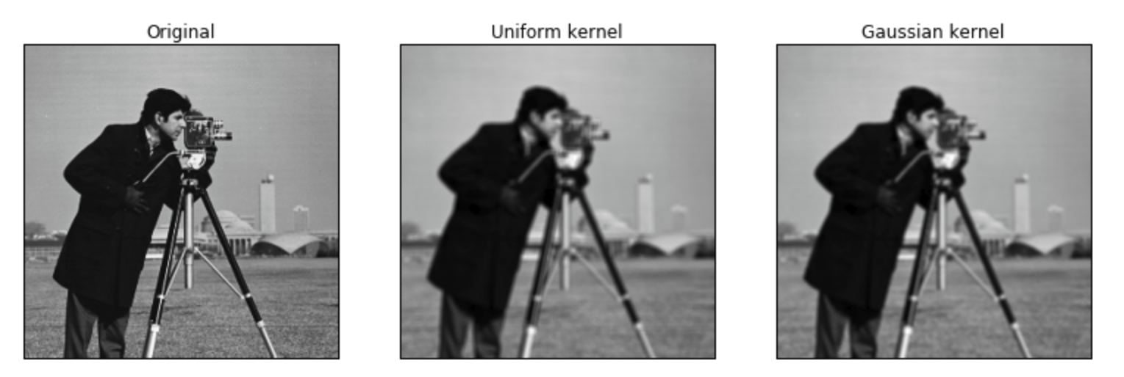

Averaging vs. Gaussian Filtering
9x9 Gaussian blur kernel
Previously, we used a uniform kernel
Now we try a Gaussian kernel
Standard deviation $σ$ controls effective width
Choose window size $K≥2σ+1$
Both blur images, but differently

Slide 29
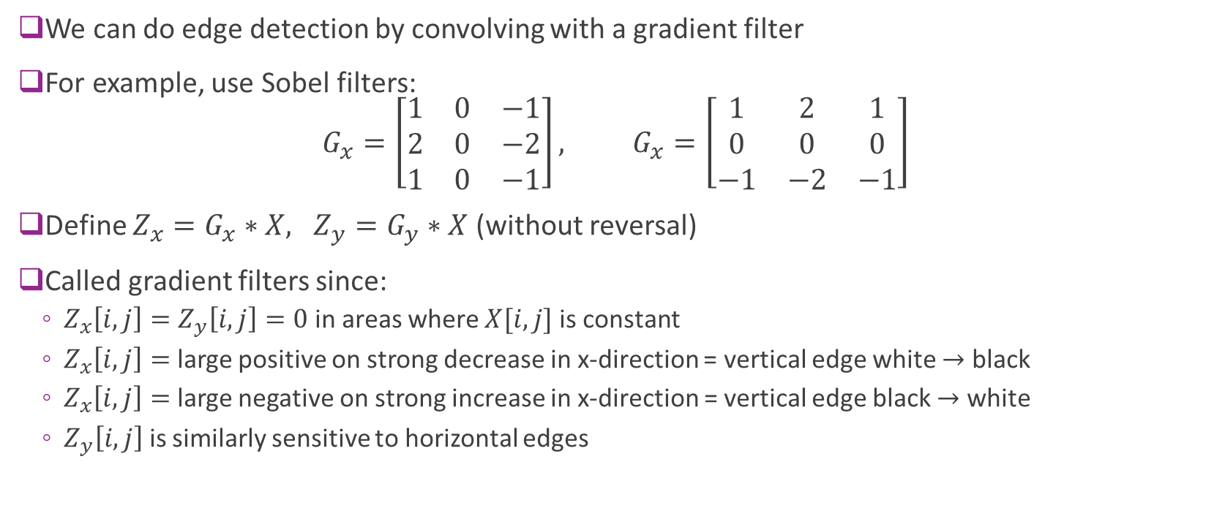
Ex 2. Convolution for Edge Detection
We can do edge detection by convolving with a gradient filter
For example, use Sobel filters: $G_{x}=\left[\begin{matrix}1 & 0 & −1 \\ 2 & 0 & −2 \\ 1 & 0 & −1\end{matrix}\right], G_{x}=\left[\begin{matrix}1 & 2 & 1 \\ 0 & 0 & 0 \\ −1 & −2 & −1\end{matrix}\right]$
Define $Z_{x}=G_{x}∗X, Z_{y}=G_{y}∗X$ (without reversal)
Called gradient filters since:
$Z_{x}\left[i,j\right]=Z_{y}\left[i,j\right]=0$ in areas where $X[i,j]$ is constant
$Z_{x}\left[i,j\right]=$ large positive on strong decrease in x-direction = vertical edge white $→$ black
$Z_{x}\left[i,j\right]=$ large negative on strong increase in x-direction = vertical edge black $→$ white
$Z_{y}\left[i,j\right]$ is similarly sensitive to horizontal edges

Slide 30
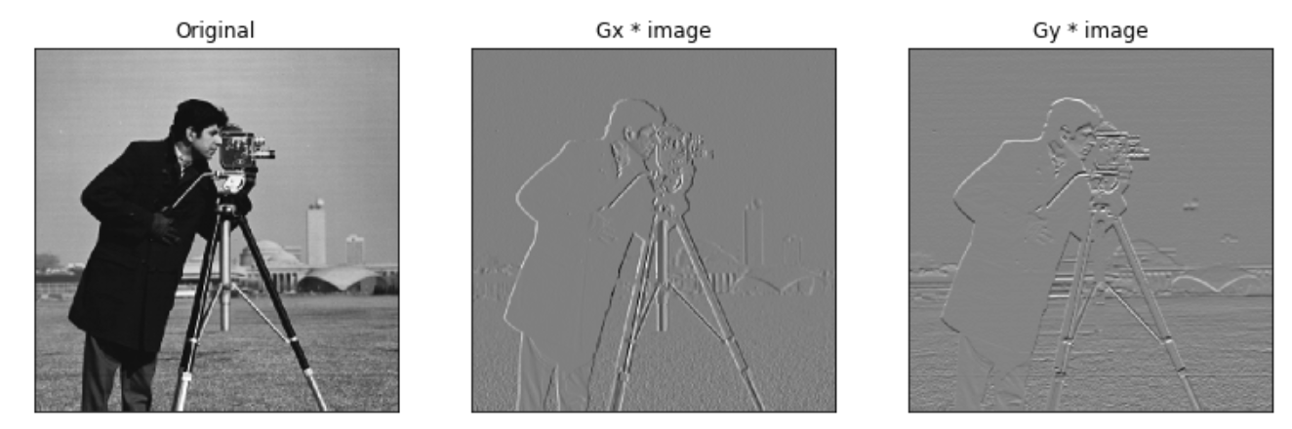
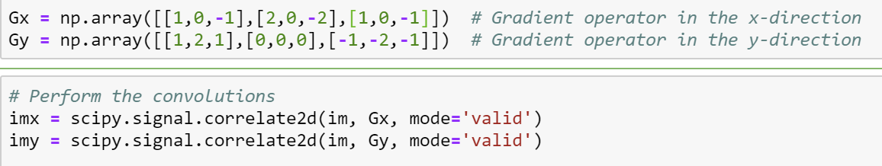
Edge Detection using Sobel Filter

Slide 31
Outline
Motivation: ImageNet Large-Scale Visual Recognition Challenge (ILSVR)
Deep Networks and Feature Hierarchies
2D convolutions
Convolutional neural networks
Creating and visualizing convolutional layers in Keras
Training CNNs: Backpropagation, Batch-norm, Dropout, etc.
Transfer Learning from Famous Pre-trained Networks

Slide 32
Classic CNN Structure
Starts with convolutional layers. Each layer does
2D convolution with several kernels
Activation (e.g., ReLU)
Sub-sampling or pooling
Finish with fully connected (or dense) layers. Each layer does . . .
Matrix multiplication
Activation
Convolutional layers
2D convolution with Activation and pooling / sub-sampling
Fully connected layers
Matrix multiplication & activation

Slide 33
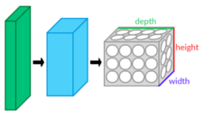
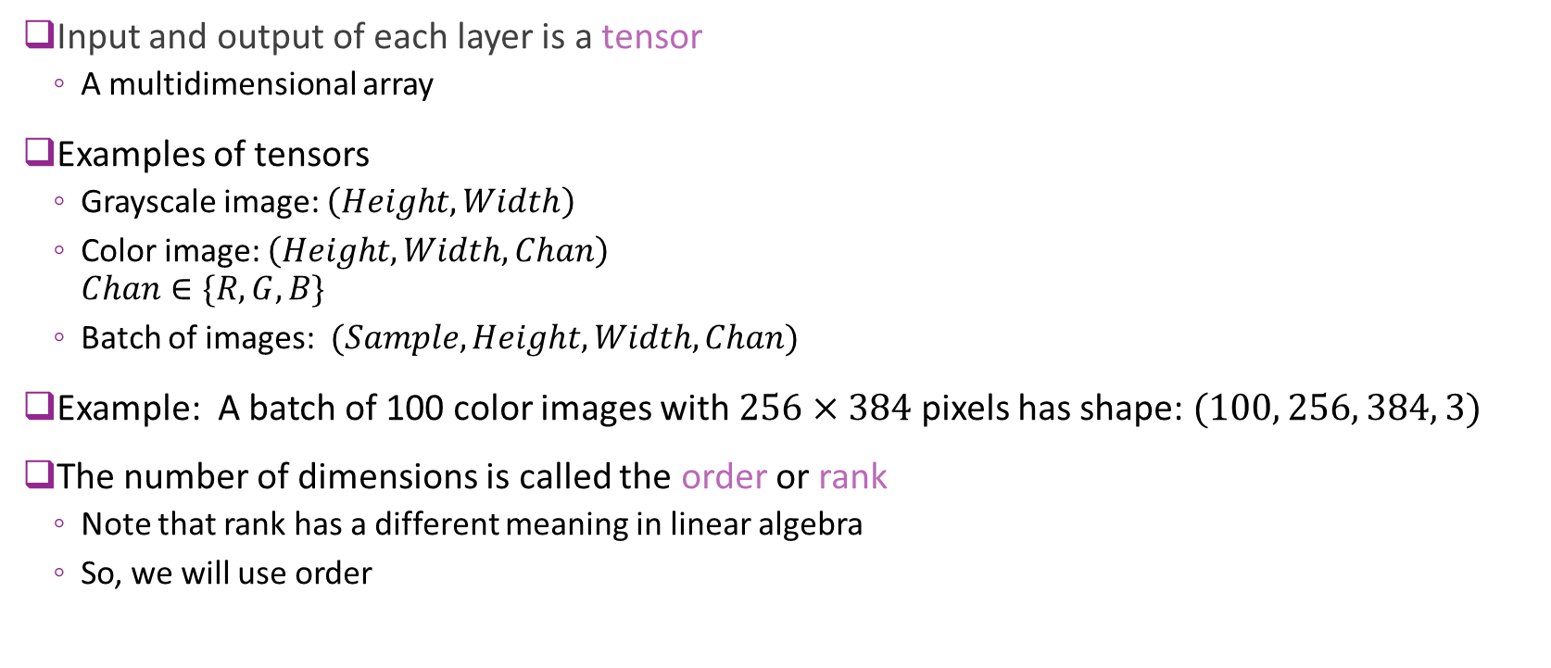
Tensors
Input and output of each layer is a tensor
A multidimensional array
Examples of tensors
Grayscale image: $\left(Height, Width\right)$
Color image: $\left(Height, Width,Chan\right)$ $Chan∈\{R,G,B\}$
Batch of images: $(Sample,Height,Width,Chan)$
Example: A batch of 100 color images with $256×384$ pixels has shape: $(100, 256, 384, 3)$
The number of dimensions is called the order or rank
Note that rank has a different meaning in linear algebra
So, we will use order

Slide 34
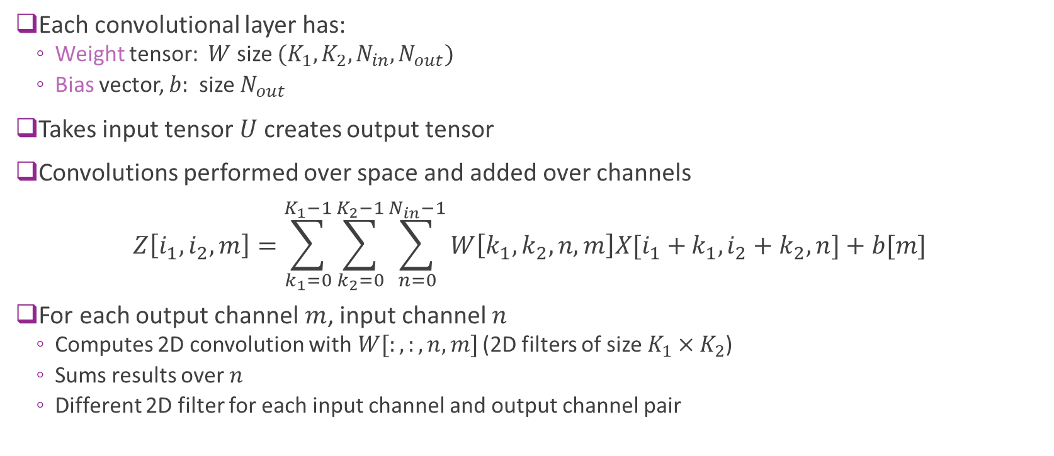
What Do Convolutional Layers Do?
Each convolutional layer has:
Weight tensor: $W$ size $(K_{1},K_{2},N_{in},N_{out})$
Bias vector, $b:$ size $N_{out}$
Takes input tensor $U$ creates output tensor
Convolutions performed over space and added over channels $Z\left[i_{1},i_{2},m\right]=\sum_{k_{1}=0}^{K_{1}−1}{\sum_{k_{2}=0}^{K_{2}−1}{\sum_{n=0}^{N_{in}−1}{W\left[k_{1},k_{2},n,m\right]X[i_{1}+}}}k_{1},i_{2}+k_{2},n]+b[m]$
For each output channel $m$, input channel $n$
Computes 2D convolution with$W[:,:,n,m]$ (2D filters of size ${K_{1}×K}_{2}$)
Sums results over $n$
Different 2D filter for each input channel and output channel pair

Slide 35
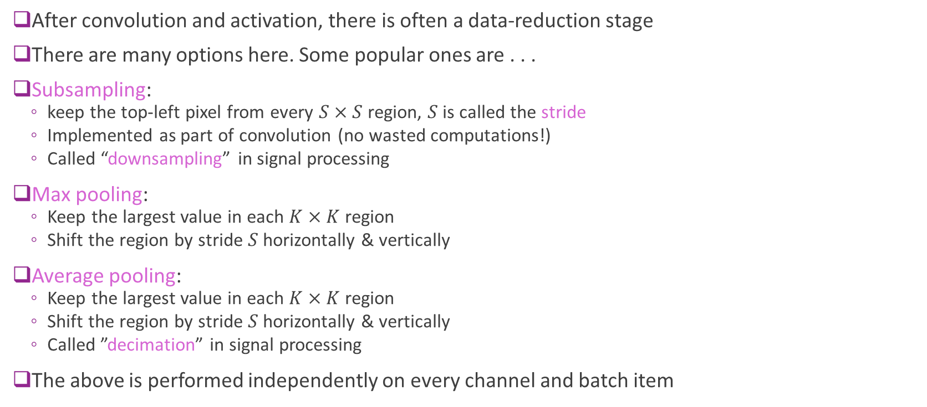
Subsampling and Pooling
After convolution and activation, there is often a data-reduction stage
There are many options here. Some popular ones are . . .
Subsampling:
keep the top-left pixel from every $S×S$ region, $S$ is called the stride
Implemented as part of convolution (no wasted computations!)
Called “downsampling” in signal processing
Max pooling:
Keep the largest value in each $K×K$ region
Shift the region by stride $S$ horizontally & vertically
Average pooling:
Keep the largest value in each $K×K$ region
Shift the region by stride $S$ horizontally & vertically
Called ”decimation” in signal processing
The above is performed independently on every channel and batch item

Slide 36
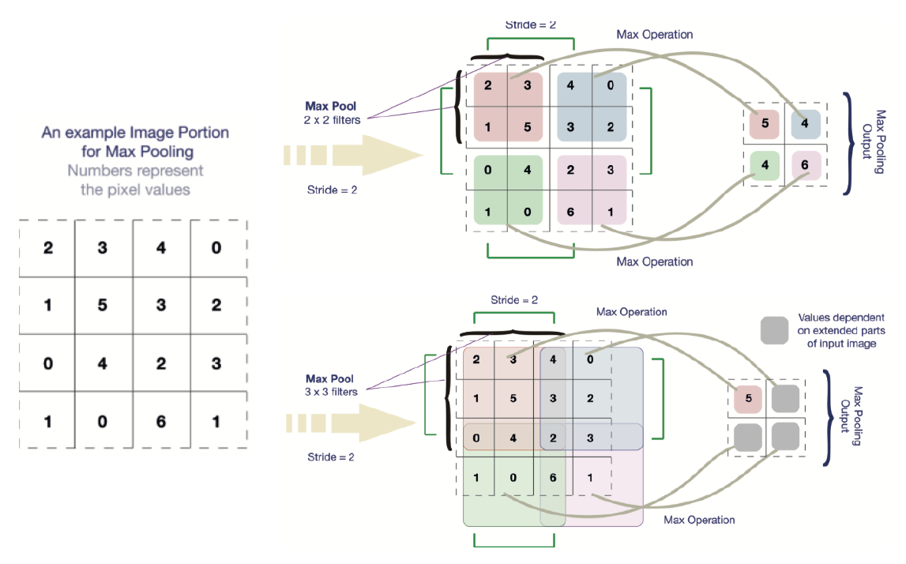
Max Pooling Illustrated

Slide 37
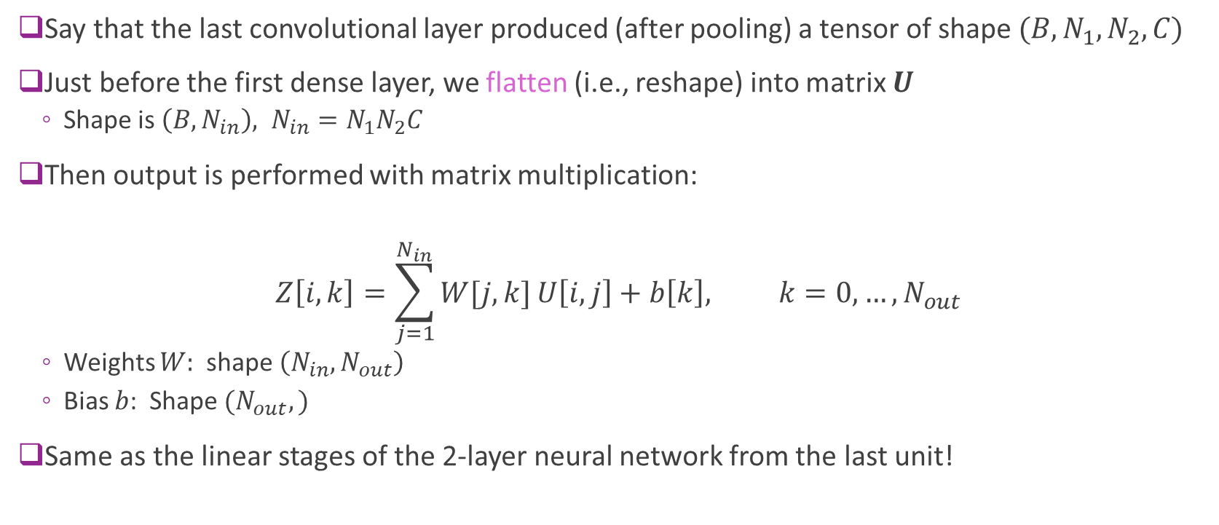
What Dense Layers Do?
Say that the last convolutional layer produced (after pooling) a tensor of shape $(B,N_{1},N_{2},C)$
Just before the first dense layer, we flatten (i.e., reshape) into matrix $U$
Shape is $\left(B,N_{in}\right), N_{in}=N_{1}N_{2}C$
Then output is performed with matrix multiplication:
$$Z\left[i,k\right]=\sum_{j=1}^{N_{in}}{W[j,k]}U\left[i,j\right]+b\left[k\right], k=0,…,N_{out}$$
Weights $W:$shape $\left(N_{in},N_{out}\right)$
Bias $b$: Shape $(N_{out},)$
Same as the linear stages of the 2-layer neural network from the last unit!

Slide 38
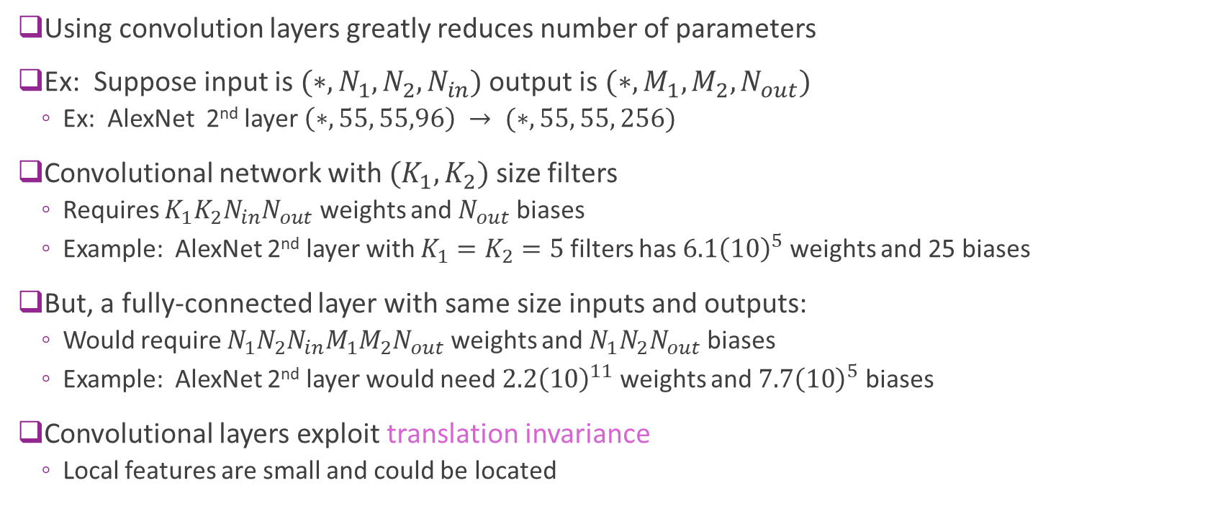
Convolution vs Fully Connected
Using convolution layers greatly reduces number of parameters
Ex: Suppose input is $(∗,N_{1},N_{2},N_{in})$ output is $(∗,M_{1},M_{2},N_{out})$
Ex: AlexNet 2nd layer $\left(∗, 55, 55,96\right) → (∗, 55, 55, 256)$
Convolutional network with $(K_{1},K_{2})$ size filters
Requires $K_{1}K_{2}N_{in}N_{out}$ weights and $N_{out}$ biases
Example: AlexNet 2nd layer with $K_{1}=K_{2}=5$ filters has $6.1{\left(10\right)}^{5}$ weights and 25 biases
But, a fully-connected layer with same size inputs and outputs:
Would require $N_{1}N_{2}N_{in}M_{1}M_{2}N_{out}$ weights and $N_{1}N_{2}N_{out}$ biases
Example: AlexNet 2nd layer would need $2.2{\left(10\right)}^{11}$ weights and $7.7{\left(10\right)}^{5}$ biases
Convolutional layers exploit translation invariance
Local features are small and could be located

Slide 39
Outline
Motivation: ImageNet Large-Scale Visual Recognition Challenge (ILSVR)
Deep Networks and Feature Hierarchies
2D convolutions
Convolutional neural networks
Creating and visualizing convolutional layers in Keras
Training CNNs: Backpropagation, Batch-norm, Dropout, etc.
Transfer Learning from Famous Pre-trained Networks

Slide 40
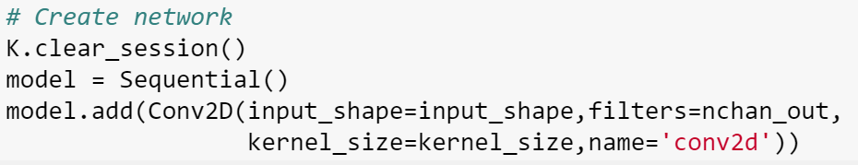
Creating Convolutional Layers in Keras
Done easily with Conv2d
Specify input_shape (if first layer), kernel size and number of output channels
To illustrate:
We create a network with a single convolutional layer
Set the weights and biases (normally these would be learned)
Run input through the layer (using the predict command)
Look at the output

Slide 41
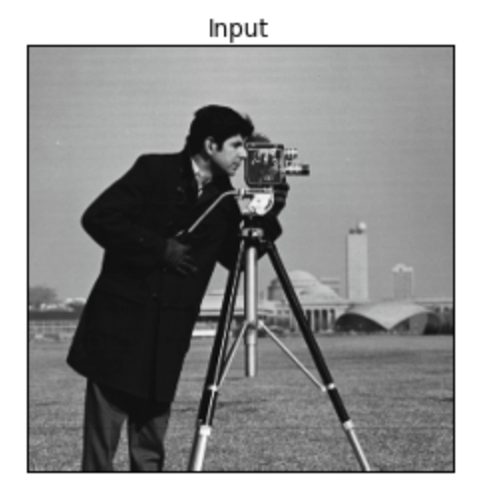

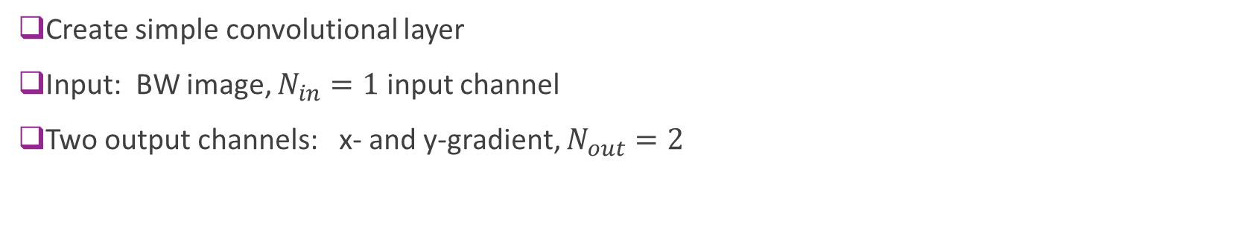
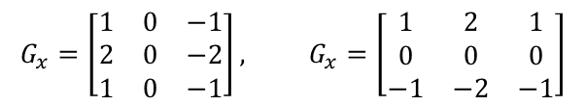
Example 1: Gradients of a BW image
Create simple convolutional layer
Input: BW image, $N_{in}=1$ input channel
Two output channels: x- and y-gradient, $N_{out}=2$
*
$$G_{x}=\left[\begin{matrix}1 & 0 & −1 \\ 2 & 0 & −2 \\ 1 & 0 & −1\end{matrix}\right], G_{x}=\left[\begin{matrix}1 & 2 & 1 \\ 0 & 0 & 0 \\ −1 & −2 & −1\end{matrix}\right]$$
Input.
One channel
Shape = (512,512,1)
Filters
Two gradient

Slide 42


Create a Layer in Keras
Create a single layer model
Use the Conv2D layer
Specify
Kernel size
Number of output channels
Input shape
Why do we have 20 parameters?

Slide 43



Set the Weights
Read the weights and the shapes
Set the weights to the two filters
Normally, these would be trained
Run the input through the network

Slide 44

Perform Convolution in Keras
Create input x
Need to reshape
Use predict command to compute output
Generates two output channels y
y[:,:,0]
y[:,:,1]
Input x
*
Filters
Two gradients

Slide 45



Example 2: Color Input
Input: Single color input
$N_{in}=3$ input channels
Input size per sample = 368 x 487 x 3
Output: Filter with four different color filters
Each kernel is 9 x 9
$N_{out}=4$ output channels
*

Slide 46

Create the Layer in Keras
Model with single layer
Input shape = (368, 488,3)
Output shape = (360,479,4)
What the number of parameters is 976?

Slide 47


Set the Weights
Consider weight of the form: $W\left[i,j,k,ℓ\right]=G\left[i,j\right]C[ℓ,k]$
$G\left[i,j\right]$= filter over space
Use Gaussian blur
$C[ℓ,k]$ = filter over channel
Weighting of color $k$ in output channel $ℓ$
Each filter:
Average over space and selects color
Again, normally we would train the weights

Slide 48


Perform Convolution
Input, x
(3 channels)
Filters, W (9,9,3,4)
*
Output y 4 channels
y[:,:,0]
y[:,:,1]
y[:,:,2]
y[:,:,3]

Slide 49
First Layer Filters in AlexNet
AlexNet first layer
96 filters
Size 11 x 11 x 3
Applied to image of 224 x 224 x 3
Each filter can be viewed as a 11x11x3 image
Selective to basic low-level features
Curves, edges, color transitions, …

Slide 50
Outline
Motivation: ImageNet Large-Scale Visual Recognition Challenge (ILSVR)
Deep Networks and Feature Hierarchies
2D convolutions
Convolutional neural networks
Creating and visualizing convolutional layers in Keras
Training CNNs: Backpropagation, Batch-norm, Dropout, etc.
Transfer Learning from Famous Pre-trained Networks

Slide 51






Indexing Multi-Layer Networks
Similar to single layer NNs
But must keep track of layers
Consider batch of image inputs:
$X[i,j,k,n]$, (sample,row,col,channel)
Input tensor at layer $ℓ$:
$U^{ℓ}[i,j,k,n]$ for convolutional layer
$U^{ℓ}[i,n]$ for fully connected layer
Output tensor from linear transform:
$Z^{ℓ}\left[i,j,k,n\right]$ or $Z^{ℓ}\left[i,n\right]$
Output tensor after activation / pooling:
$U^{ℓ+1}\left[i,j,k,n\right]$ or $U^{ℓ+1}\left[i,n\right]$
Convolution or fully-connected
Activation, pooling
$$U^{ℓ}$$
$$Z^{ℓ}$$
$$U^{ℓ+1}$$
$$W^{ℓ},b^{ℓ}$$
Weight-bias

Slide 52











Back-Propagation in Convolutional Layers
Input $$X$$
Convolution $$Z^{ℓ}=W^{ℓ}∗U^{ℓ}+b^{ℓ}$$
Loss function $$J\left(θ\right)$$
$$U^{ℓ}$$
$$⋯$$
$$⋯$$
$$\frac{∂J}{∂U^{ℓ }}$$
$$\frac{∂J}{∂Z^{ℓ }}$$
Convolutional layer in forward path
$$Z^{ℓ}=W^{ℓ}∗U^{ℓ}+b^{ℓ}$$
During back-propagation:
Obtain gradient tensor from upstream layers $\frac{∂J}{∂Z^{ℓ }}$
Need to compute downstream gradients: $\frac{∂J}{∂W^{ℓ }}, \frac{∂J}{∂b^{ℓ}}, \frac{∂J}{∂U^{ℓ}}$
$$\frac{∂J}{∂W^{ℓ }}, \frac{∂J}{∂b^{ℓ}}$$
$$W^{ℓ},b^{ℓ}$$

Slide 53

Gradient Details
Write convolution as: $Z\left[i_{1},i_{2},m\right]=\sum_{k_{1}=0}^{K_{1}−1}{\sum_{k_{2}=0}^{K_{2}−1}{\sum_{n=0}^{N_{in}−1}{W\left[k_{1},k_{2},n,m\right]U[i_{1}+}}}k_{1},i_{2}+k_{2},n]+b\left[m\right]$
Drop layer index $ℓ$ and sample index $i$
In backpropagation, we receive gradient tensor: $\frac{∂J}{∂Z\left[i_{1},i_{2},m\right]}$
First compute gradient wrt weights: $\frac{∂J}{∂W[k_{1},k_{2},n,m]}$

Slide 54

Gradient With Respect to Weights
Gradient wrt weights:
$$\frac{∂Z\left[i_{1},i_{2},m\right]}{∂W[k_{1},k_{2},n,m]}=U\left[i_{1}+k_{1},i_{2}+k_{2},n\right]$$
By chain rule: $\frac{∂J}{∂W[k_{1},k_{2},n,m]}=\sum_{i_{1}=1}^{N_{1}}{\sum_{i_{2}=1}^{N_{2}}{\frac{∂Z\left[i_{1},i_{2},m\right]}{∂W[k_{1},k_{2},n,m]}}}\frac{∂J}{∂Z\left[i_{1},i_{2},m\right]}$ $=\sum_{i_{1}=1}^{N_{1}}{\sum_{i_{2}=1}^{N_{2}}{U[i_{1}+k_{1},i_{2}+k_{2},n]}}\frac{∂J}{∂Z\left[i_{1},i_{2},m\right]}$
Gradient wrt weights can be computed via convolution
Convolve input $U$ with gradient tensor $\frac{∂J}{∂Z\left[i_{1},i_{2},m\right]}$
Similar computations for gradients with respect to $\frac{∂J}{∂b}, \frac{∂J}{∂U}$
See homework

Slide 55

GPUs
State-of-the-art networks involve millions of parameters
Require enormous datasets
Conventional processors cannot train in reasonable time
Use Graphics Processor Units
Originally for graphics acceleration
Now essential for deep learning
Cannot use the GPU on your laptop
But, can:
Rent GPU instances in cloud (~$0.80 / hour)
Purchase GPU workstation (~$2000)

Slide 56

Batch Normalization
Important speed up method
See general discussion here,
CNN-specific discussion here
Recall good practice: Standardize the raw features X
that is, for each feature:
Make mean = 0 and variance = 1 over each minibatch
Batch normalization:
We first standarize the outputs in each channel and layer, and
Then learn an optimal mean & variance for them:
Sergey Ioffe, Christian Szegedy: Batch Normalization: Accelerating Deep Network Training by Reducing Internal Covariate Shift.
https://arxiv.org/pdf/1502.03167v3.pdf

Slide 57
Batch Normalization
Batch norm allows higher learning rates, thus reduced training times, because
it reduces variation across channels and minibatches
it helps to decouple layers
it makes the cost function smoother
Below is an example from the original paper:
The “5” and “30” refer to learning-rate increases over the baseline

Slide 58

DropOut
Dropout: Technique to reduce overfitting during training
Idea: temporarily remove a random subset of neurons
Use in fully-connected layers only!
Motivation: Prevent co-adaptation;
Neurons should work well on their own
Details:
Multiply each input by an Bernoulli random variable $D∈\{0,1/p\}$
$P\left(D≠0\right)=p$ is a design parameter (usually use $p=0.5$)
During test time, don’t remove any units
Note: increases # of training epochs, but should decrease complexity per epoch
First introduced in 2012, dropout seems to be getting less popular now
Networks are becoming deeper, and less dense layers are being usedl
Srivastava, Nitish, et al. ”Dropout: a simple way to prevent neural networks from overfitting”, JMLR 2014

Slide 59

Data Augmentation
Often our training dataset is smaller than we’d like
Idea: Augment the dataset
Generate additional images by flipping, shifting, scaling, rotating, and cropping

Slide 60


CIFAR10 Demo
CIFAR10 problem:
Classify 32x32 color images
10 classes
Use simple network
2 conv layers + 2 FC layers
RMS prop with lr=${10}^{−3}$, decay=${10}^{−4}$
Batch size=$32$
100 epochs
Note:
Exact accuracy varies with optim parameters
Full demo on github
Method | Final test accuracy
Baseline | ~70%
Batch norm | ~74%
Batch norm+dropout | ~78% (dropout on FC layers)
Batch norm+dropout + data augmentation | ~76% (enough data)

Slide 61
Outline
Motivation: ImageNet Large-Scale Visual Recognition Challenge (ILSVR)
Deep Networks and Feature Hierarchies
2D convolutions
Convolutional neural networks
Creating and visualizing convolutional layers in Keras
Training CNNs: Backpropagation, Batch-norm, Dropout, etc.
Transfer Learning from Famous Pre-trained Networks

Slide 62

Pre-Trained Networks
State-of-the-art networks take enormous resources to train
Millions of parameters
Often days of training, clusters of GPUs
Extremely expensive
Pre-trained networks in Keras
Load network architecture and weights
Models available for many state-of-the-art networks
Can be used for:
Making predictions
Building new, powerful networks (see lab)
https://keras.io/applications/

Slide 63

VGG16
From the Visual Geometry Group
Oxford, UK
Won ImageNet ILSVRC-2014
Based on small early filters
But more layers
Remains a repectable network
Lower lower layers are often used as feature extraction layers for other tasks
K. Simonyan, A. Zisserman
Very Deep Convolutional Networks for Large-Scale Image Recognition
arXiv technical report, 2014

Slide 64

GoogleLeNet / Inception-v1
From 2012 (AlexNet) to 2014 (VGG-16), performance got better as networks got deeper
But, the number of parameters was getting out of hand (e.g., 60 to 180 million!)
So, Google researchers worked to design a network that was deeper, but much more efficient
From the film Inception (2010)
Used only 5 million parameters!
Won some contests in ImageNet ILSVRC-2014
Achieved top-5 error of 6.7% (VGG got 7.3%)
Used 22 layers with “inception modules”
Several conv layers in parallel, with different kernel sizes
Key idea: for bigger kernels, use fewer channels
Multi-size kernels also help make scale-invariant
Good overview here

Slide 65

Residual Networks
Through 2015, the best networks got deeper. But deep nets are hard to train:
vanishing gradients (largely solved by ReLU & batchnorm)
degradation problem: as networks get deeper, even training error increaes!
A deeper network should be able to perform at least as good as a shallower network,
Making some layers act like identity
But difficult to make layers act like identity!
Idea: Make identity easy via residual blocks:
Handle dimension changes w/ learned dense layer
ResNet, introduced by Microsoft Research, Dec 2015
Solves degradation problem; allows super deep networks! (100s of layers)
Won ImageNet ILSVRC-2015 with 3.6% error rate! (GoogLeNet got 6.7%)
Slightly lower complexity than VGG

Slide 66

Other Networks in the Deep Learning Zoo

Slide 67


Loading the Pre-Trained Network
Load the packages
Create the model
Downloads the h5 file
First time, may be a while (500 MB file)

Slide 68


Display the Network
Very deep: 16 layers (Do not count pooling layers)
130 million parameters!

Slide 69

Get Some Test Images
Get images from the web of some category (e.g. elephants)
Many possible sources.
Example: Flickr API (see Demo in github)
Re-size / pad images so that they match expected input of VGG16
Input shape (224, 224, 3)

Slide 70



Make Predictions
Pre-process
Predict
Runs input through network
Decode predictions
Creates data structure for outputs

Slide 71

ImageNet Classification can be Hard
Some categories differences are subtle

Slide 72



Intermediate Layers
Often need outputs of hidden layers
Provides “latent” representation of image
Can be useful for other tasks
See lab
In Keras, create new model
Specify output layers
Predict with new model to extract hidden outputs
Hidden layers see high level of sparsity
Many coefficients are zero

Slide 73
Output of first few convolution layers
Output of first convolution layers (first 4 channels) for a given image
First, third, and fourth channels looks like gradient images in different directions
In general, first few layers extract low level features!

Slide 74
Output of higher layers
Output of last layer before the flatten layer (first 4 channels)
These carry “high level semantic information” about object category
See demo for outputs of other layers

Slide 75


Try It Yourself!
= ?

Slide 76
Autoencoder
CNN is not limited for classification!
When all the layers are convolution, the output can have the same shape as the input (speech->speech, image->image)
Autoencoder= Encoder+Decoder
Encoder: image-> features;
Decoder: features -> image

Slide 77
Demo: Autoencoder for image denoising
Using a subset of training samples in the cifar10 dataset
2 encoding layers producing 32 (or 16) channels, 3 decoding layers

Slide 78
Other Applications of autoencoders
Image processing applications:
Image compression
Image segmentation
Saliency detection
Other applications
Unsupervised feature extraction
Speech denoising …
Language translation
…
Autoencoder loss depends on the underlying application
Using adversarial loss can help to make the output look more like the target output (beyond this class)
https://github.com/arahusky/Tensorflow-Segmentation

Slide 79

Lab: Transfer Learning
For image classification or other applications, training from scratch takes tremendous resources
Instead, can refine the VGG or other well trained networks for Task A (e.g. imagenet)
Build a new network for Task B
Use early layers from first network
Freeze those parameters
Only train small number of parameters at end
Greatly reduces number of parameters for Task B
Can be trained on ~1000 images
Task A
Task B

